Slide 1
Economic Conditions of the 1 Journal Square Area Evans, Carroll & Associates, Inc. May 12, 2017

Slide 2
Executive Summary
1 Journal Square’s surrounding neighborhood is in desperate need of redevelopment and economic investment. This project is helping bring immediate injection of jobs and a long-term opportunity for steady growth.
The 1 Journal Square (1JS) project is projected to generate 6,616 permanent, new jobs. This projection is based on the RIMS II Input/Output Model, which is the industry standard for economic impact modeling.
Based on data from the U.S. Census Bureau, in the 1-mile area surrounding 1JS:
More than 1 in 6 families (17%) live in poverty, 55% higher than the national family poverty rate (11%).
More than 1 in 5 people (21%) do not have health insurance, 62% higher than the U.S. rate (13%).
Incredibly, more than half (56%) of residences were built in 1939 or earlier, as compared to just 13% nationally; this further underscores the need for new housing in the area.
The broader economy of Hudson County, NJ, is stagnating and needs stimulus. 1JS will play a critical role in a broader revitalization of the County.
The labor force decreased in 2016, after rising nearly 2,000 per year over the prior 5 years.
Average compensation rose only 0.6% in 2015, after rising an average of 2.3% per year over the prior 5 years.

Slide 3
In the Area Surrounding 1 Journal Square, More than 1 in 6 Families Live in Poverty
Of the 21 counties in New Jersey, Hudson has the highest family poverty rate
Source: U.S. Census Bureau, 2011-2015 American Community Survey 5-Year Estimates
Census Tract (CT) 19 in Hudson County, NJ is the location of the 1 Journal Square building

Slide 4
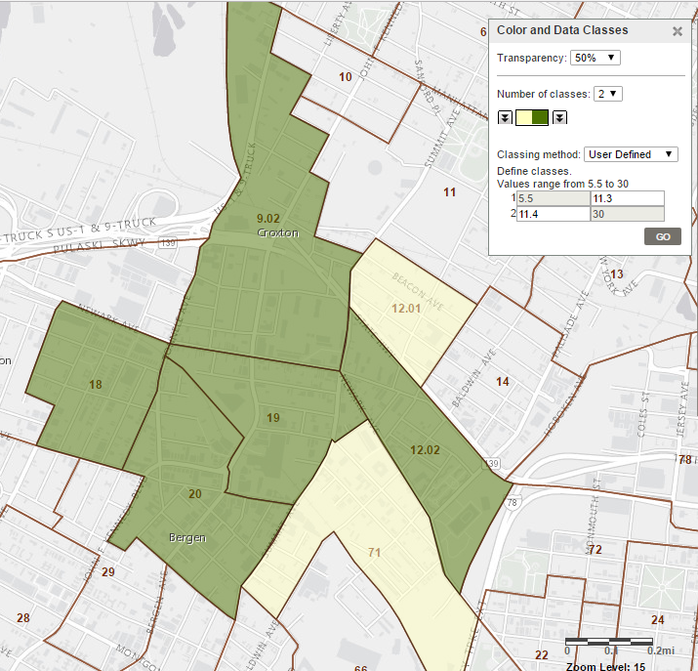
Within ½ Mile of 1 Journal Square, 5 of 7 Census Tracts have Higher Family Poverty Rates than the U.S. Average
Source: U.S. Census Bureau, 2011-2015 American Community Survey 5-Year Estimates
Census Tract (CT) 19 in Hudson County, NJ is the location of the 1 Journal Square building

Slide 5
In the Area Surrounding 1 Journal Square, 1 in 3 Families Earn Less than $35,000 per Year
0 Families in Hudson County CT 19 earn more than $150,000 per year
Source: U.S. Census Bureau, 2011-2015 American Community Survey 5-Year Estimates
Census Tract (CT) 19 in Hudson County, NJ is the location of the 1 Journal Square building

Slide 6
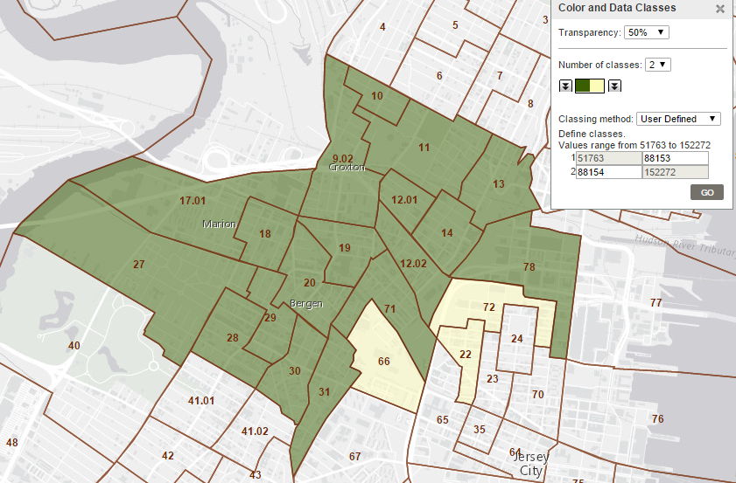
Within 1 Mile of 1 Journal Square, 18 of 21 Census Tracts have a Lower Mean Family Income than the U.S. Average
Source: U.S. Census Bureau, 2011-2015 American Community Survey 5-Year Estimates
Census Tract (CT) 19 in Hudson County, NJ is the location of the 1 Journal Square building

Slide 7
In the Area Surrounding 1 Journal Square, 1 in 5 People do not Have Health Insurance
79% of the unemployed in CT 19 have no health insurance (vs. 41% nationally)
Source: U.S. Census Bureau, 2011-2015 American Community Survey 5-Year Estimates
Census Tract (CT) 19 in Hudson County, NJ is the location of the 1 Journal Square building

Slide 8
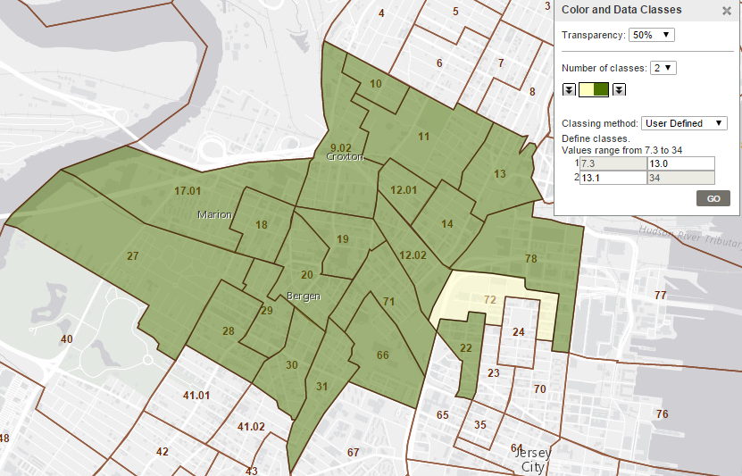
Within 1 Mile of 1 Journal Square, 20 of 21 Census Tracts have More People with No Health Insurance than the U.S. Average
Source: U.S. Census Bureau, 2011-2015 American Community Survey 5-Year Estimates
Census Tract (CT) 19 in Hudson County, NJ is the location of the 1 Journal Square building

Slide 9
Incredibly, in the Area Surrounding 1 Journal Square, Half of Residences Were Built Prior to 1940
This further underscores the need for new housing in the area
Source: U.S. Census Bureau, 2011-2015 American Community Survey 5-Year Estimates
Census Tract (CT) 19 in Hudson County, NJ is the location of the 1 Journal Square building

Slide 10
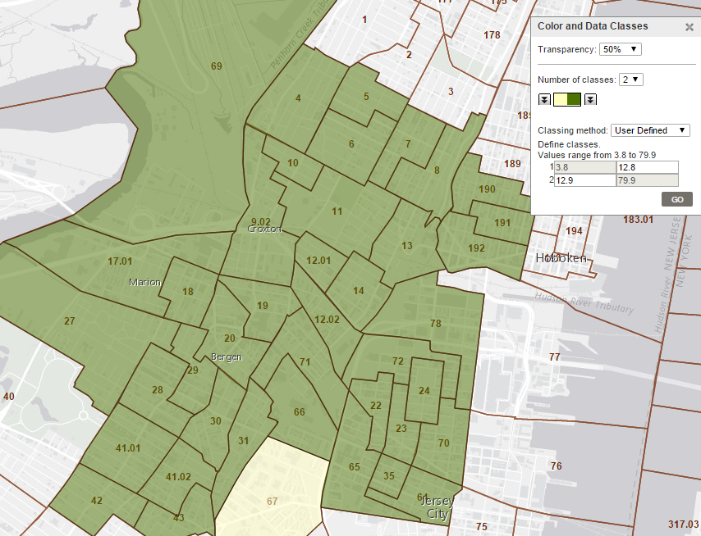
Within 1 ½ Miles of 1 Journal Square, 40 of 41 Census Tracts have More Housing Built Prior to 1940 than the U.S. Average
Source: U.S. Census Bureau, 2011-2015 American Community Survey 5-Year Estimates
Census Tract (CT) 19 in Hudson County, NJ is the location of the 1 Journal Square building

Slide 11
Hudson County’s Labor Force Decreased in 2016, after Rising 2,000 per Year for the past 5 Years
Hudson County’s labor force in March 2017 declined 1,997 since March 2016
Source: Bureau of Labor Statistics, Local Area Unemployment Statistics
Hudson County, NJ is the location of the 1 Journal Square building

Slide 12
Average Compensation in Hudson County Rose Only 0.6% in 2015, after Rising 2.3% per Year for the past 5 Years
By contrast, average compensation in the U.S. Increased 2.8% in 2015
Source: Bureau of Economic Analysis, Local Area Personal Income and Employment
Hudson County, NJ is the location of the 1 Journal Square building

Slide 13
Appendix

Slide 14
The 1 Journal Square Project is Projected to Generate 6,616 Permanent, New jobs
Source: Evans, Carroll & Associates, Inc., Economic Impact of Development of a Mixed-Use Residential and Commercial Building at 1 Journal Square, Jersey City, Hudson County, NJ, as Part of an EB-5 Regional Center in the New York City Metropolitan Area, April 19, 2017

Slide 15
Evans, Carroll & Associates, Inc.
Evans, Carroll & Associates, Inc. (formerly Evans Economics) has been providing economic forecasting and consulting to clients since 1981. Previously, Dr. Michael K. Evans was founder and president of Chase Econometric Associates, Inc.
In recent years, Evans, Carroll has specialized in providing the underlying economic analysis for EB-5 programs, determining the number of total permanent new jobs that will be created by new projects funded by foreign investors in EB-5 regional centers. It has become the leading firm offering this type of analysis.
Evans, Carroll uses the IMPLAN and RIMS II regional input/output models to calculate the employment or output multipliers for each project, but that is only one of many steps in preparing the overall report. The estimates of the direct new jobs created must be carefully calculated and can differ depending on local economic conditions, existing businesses in the area, and -- in multi-dimensional projects -- the mix of retail shopping, restaurants, offices, hotels, and other commercial buildings. Evans, Carroll uses RIMS II for several reasons, including greater transparency, and a preference by USCIS.
Evans, Carroll has also provided economic analysis for a large variety of other types of businesses, including but not limited to dairy farms, aquaculture, oil and gas drilling, alternative energy sources, research and development facilities, shipbuilding, inland ports, movie production, community centers, sports stadiums, and many other business opportunities.

